Slide 1
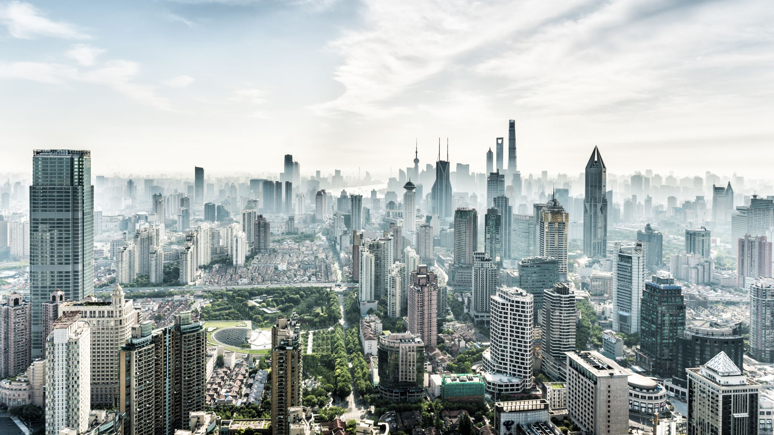
THE CALL TO ARISE
12 jan 2020

Slide 2
ARISE & BUILD
Matthew 16:18 NKJV
“…I will build my church, and the gates of Hades^{[b]} will not overcome it.”
2 Peter 3:9 NIV
“…not wanting anyone to perish, but everyone to come to repentance.”

Slide 3
ARISE & BUILD – Three-pronged Strategy for Multiplication
Preaching & Sharing the gospel so that new people will be won into the kingdom
Building the new believers into disciples by preaching & teaching. Empowering them to move in the supernatural.
Sending these new disciples out to bring pre-believers into God’s kingdom & making disciples

Slide 4
ARISE & GO
God gives His people kingdom assignments
Examples:
Acts 10:19 – The Holy Spirit told Peter to arise and go with servants of Cornelius the centurion
Acts 8 - Philip and the Ethiopian Eunuch

Slide 5
ARISE & SHINE
Isaiah 60:1-3 NIV
“Arise, shine, for your light has come, and the glory of the Lord rises upon you. See, darkness covers the earth and thick darkness is over the peoples, but the Lord rises upon you and his glory appears over you. Nations will come to your light, and kings to the brightness of your dawn.”
Matthew 5:14-16 NIV
“You are the light of the world. A town built on a hill cannot be hidden. Neither do people light a lamp and put it under a bowl. Instead they put it on its stand, and it gives light to everyone in the house. In the same way, let your light shine before others, that they may see your good deeds and glorify your Father in heaven.”

Slide 6
ARISE & SHINE – How can we shine for Christ?
1. Do Not Complain
Philippians 2:14 ”Do everything without grumbling or arguing,”
I Timothy 6:6 “But godliness with contentment is great gain.”
Philippians 4:11 “I am not saying this because I am in need, for I have learned to be content whatever the circumstances.“
2. Be Blameless
Philippians 2:15 ” so that you may become blameless and pure, “children of God without fault in a warped and crooked generation.”^{[a]} Then you will shine among them like stars in the sky
3. Hold Fast to the Word of God
Philippians 2:16 ” as you hold firmly to the word of life. And then I will be able to boast on the day of Christ that I did not run or labor in vain.”

Slide 7
ARISE & PRAY
John 5:19-20 NIV
“Jesus gave them this answer: “Very truly I tell you, the Son can do nothing by himself; he can do only what he sees his Father doing, because whatever the Father does the Son also does. For the Father loves the Son and shows him all he does. Yes, and he will show him even greater works than these, so that you will be amazed.”
Example: Joshua called to arise & go into the Promised Land

Slide 8
ARISE & PRAY
Romans 12:12 “Be joyful in hope, patient in affliction, faithful in prayer.”
1 Thessalonians 5:17 “ pray continually,”
Ephesians 6:18 “And pray in the Spirit on all occasions with all kinds of prayers and requests. With this in mind, be alert and always keep on praying for all the Lord’s people.”

Slide 9
ARISE & LEAD
How do we prepare ourselves in response to God’s Call?
From the book of NEHEMIAH:
Fully Committed to the work
Work together as a team
Be prepared to battle with the enemy
Turn to God when facing any problem
Help & Encourage one another

Slide 10
SUMMARY
ARISE & BUILD
ARISE & GO
ARISE & SHINE
ARISE & PRAY
ARISE & LEAD

